Slide 1
Final Project Presentation
ALY 6010 : Probability Theory and Introductory Statistics

Slide 2





Data Analysis
COLLECTING DATA
DATA CLEANING
Uber/Lyft
EDA
VISUALIZATION
HYPOTHESIS TESTING
REGRESSION MODELS

Slide 3

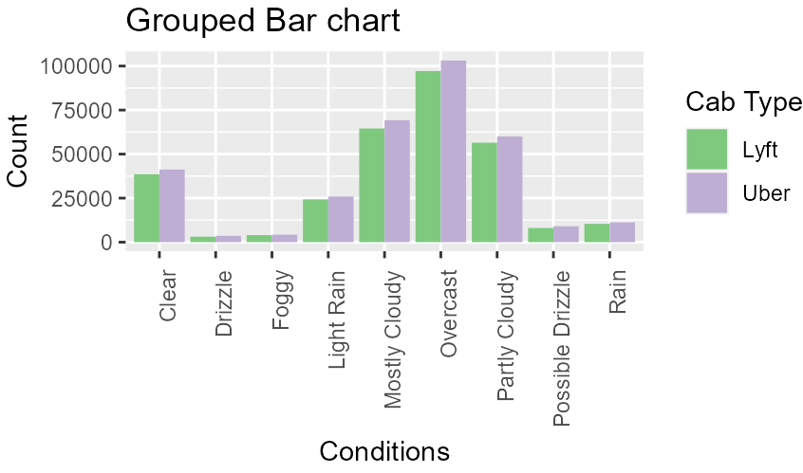


Data Visualization
As we can see that majority people prefer to take a cab during overcast conditions.
People prefer uber over lyft overall.
During foggy and rainy conditions people do not take cabs.

Slide 4

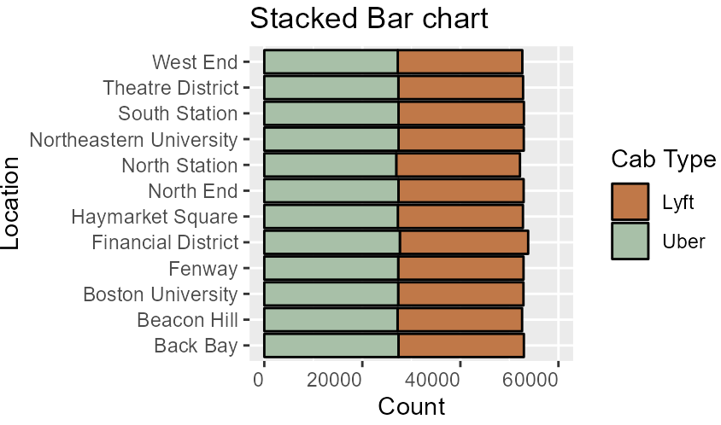

Data Visualization
This graph gives the number of rides in different locations based on cab type
Financial District in Boston is a popular location which is located in the downtown area. So, It tends to have the most rides

Slide 5

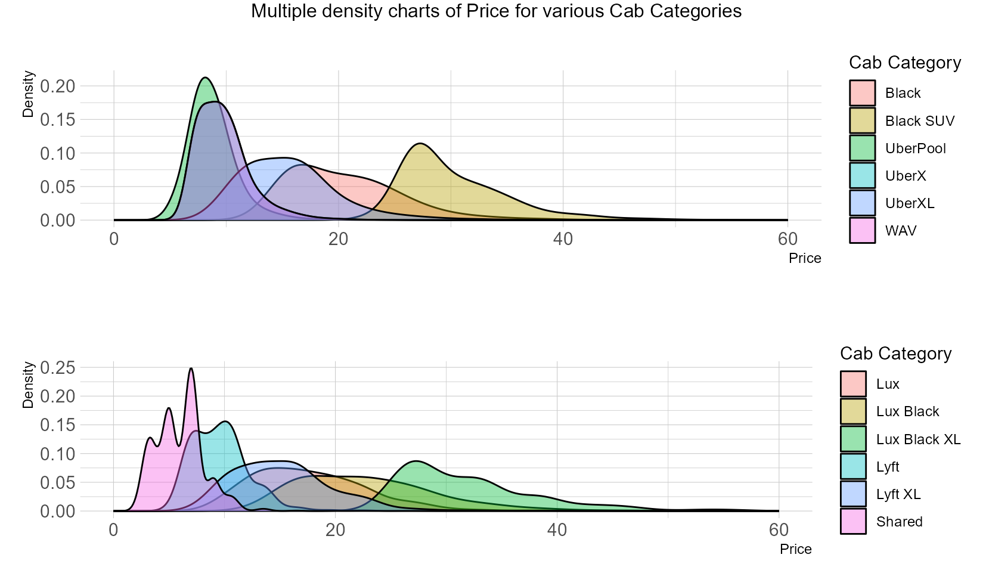


Data Visualization
Uber pool and WAV have the highest density. Uber black has the lowest density.
People generally prefer cheaper options such as shared and normal rides.
Shared and normal lyft have the highest density while Lux black XL and Lax lyft has the lowest density.

Slide 6
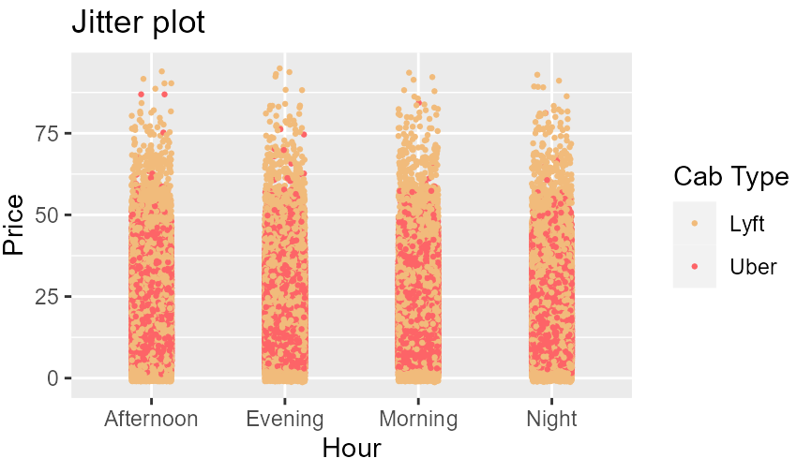


Data Visualization
Lyft charges the highest price regardless of the hour of the day.
Uber is comparatively cheaper
Morning hour has the highest density

Slide 7

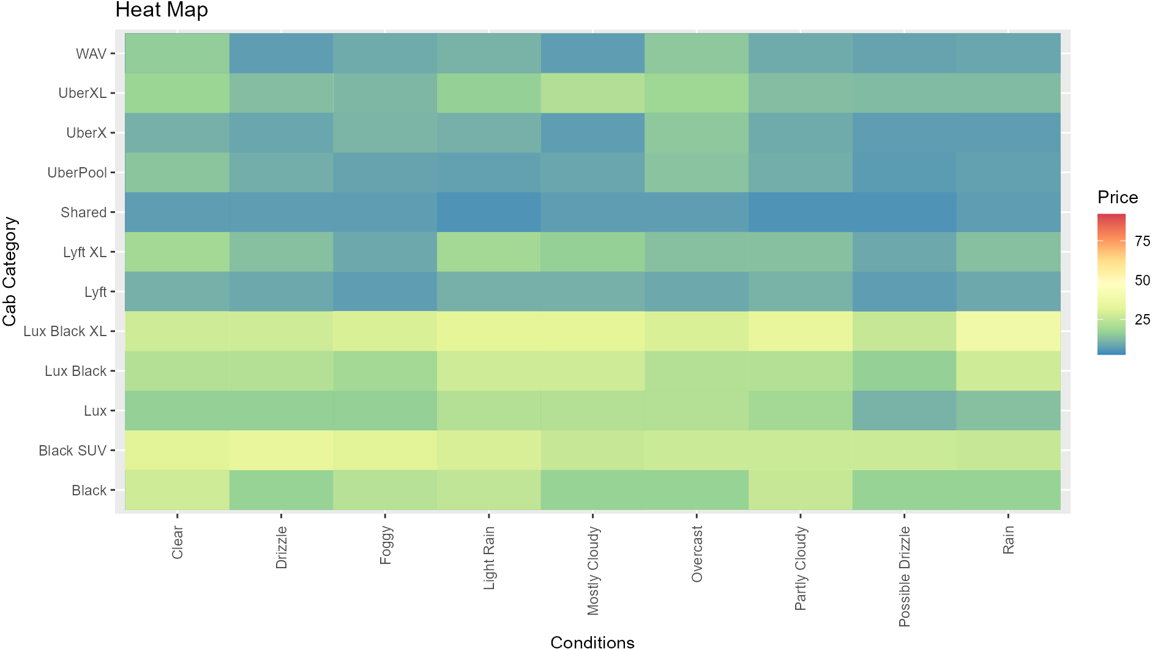


Data Visualization
Uber pool and shared have similar rates regardless of the conditions except during overcast conditions.
The expensive ride types have high price regardless of the conditions.
Clear conditions have the cheapest fair amongst all other conditions.

Slide 8

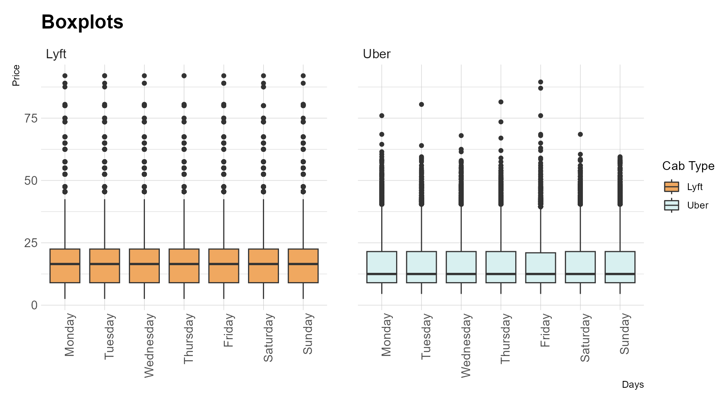

Data Visualization
Lyft has a higher median than uber.
Both the mean price range is between 0-25.
Lyft has higher charges of 70+

Slide 9
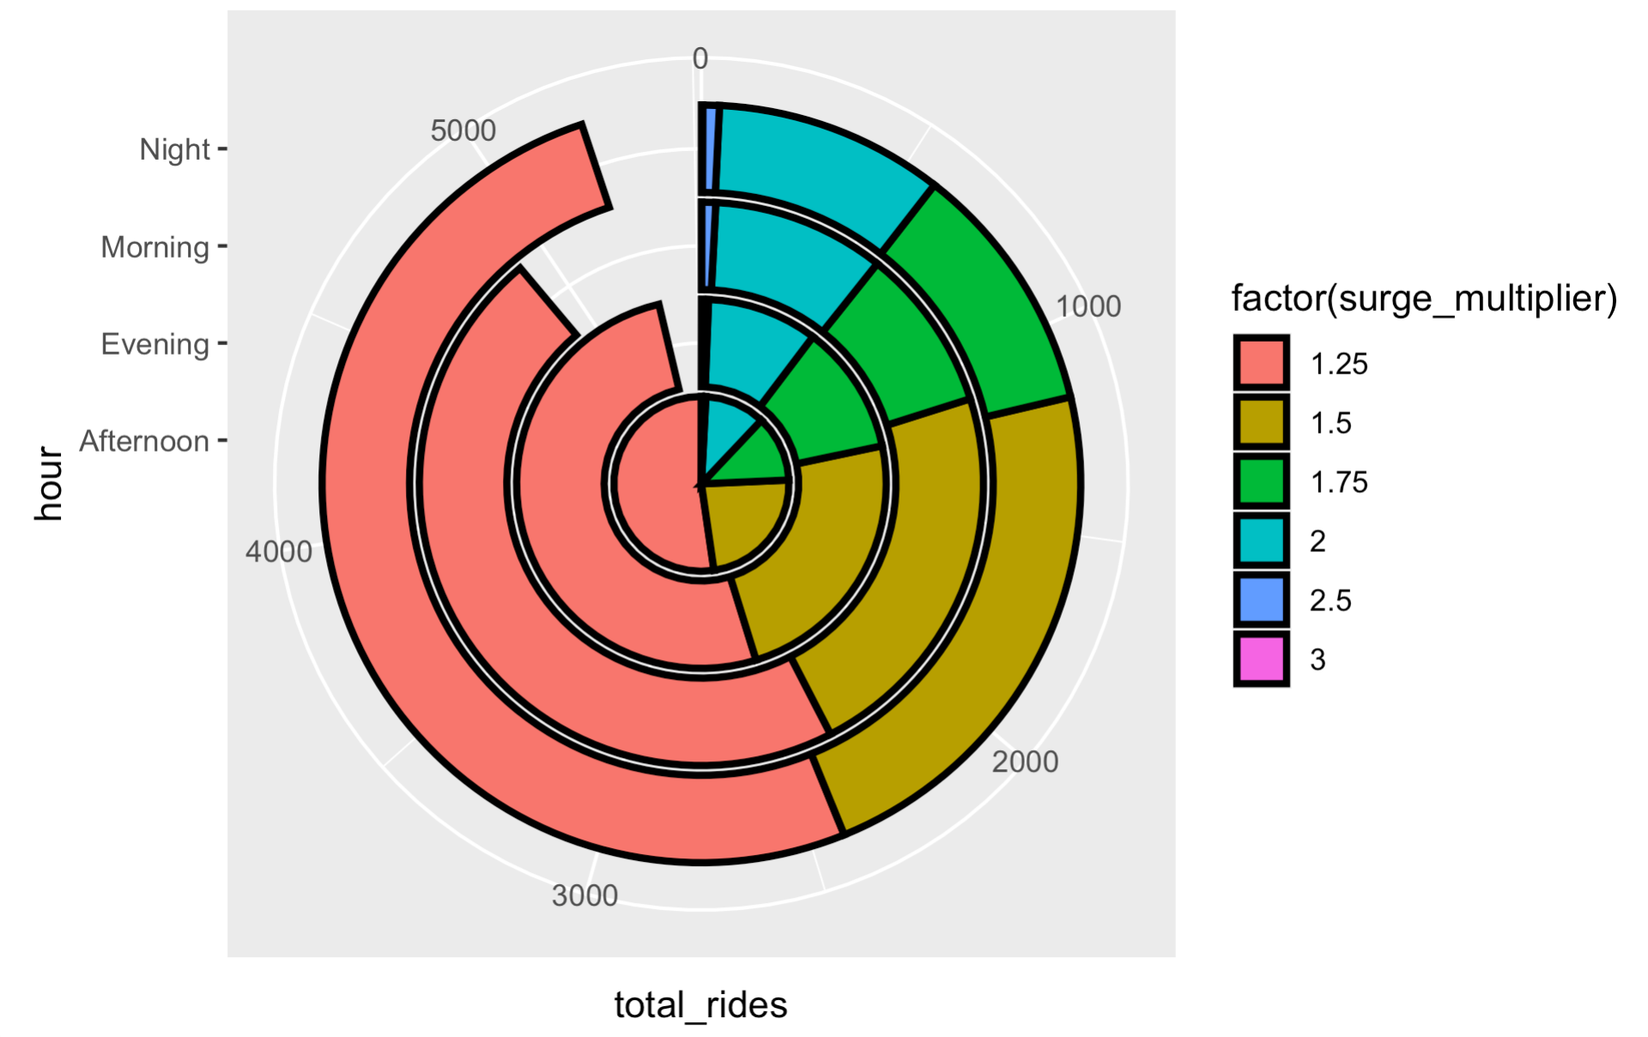

Data Visualization
1.25 surge multiplier occurs for the max number of rides
People use cabs mostly in the Afternoon followed by Night

Slide 10
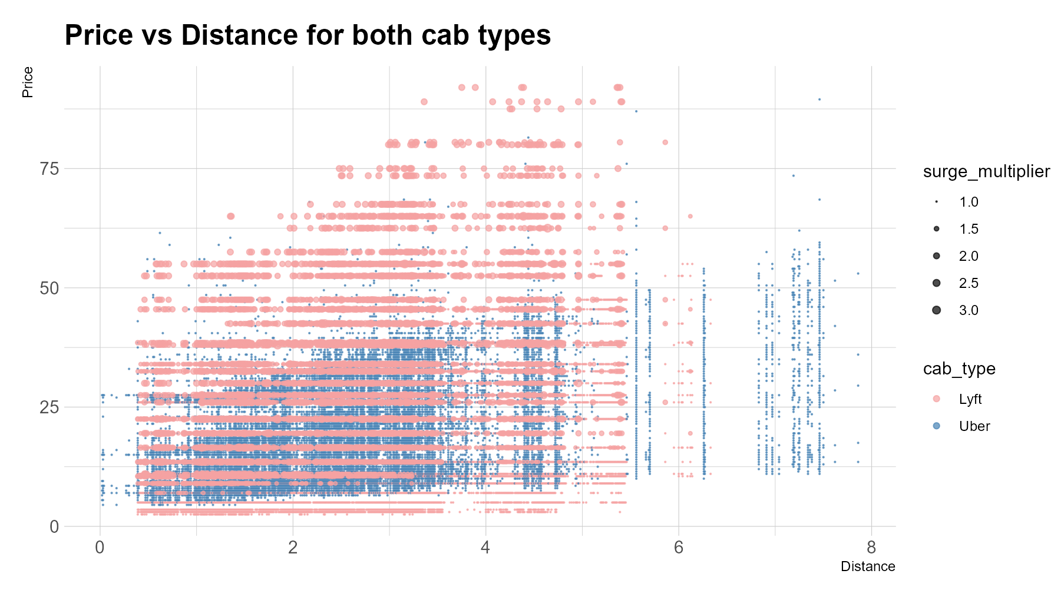
Data Visualization
Lyft charges higher price for shorter distance compared to uber and, also charges higher surge rate compared to uber.

Slide 11
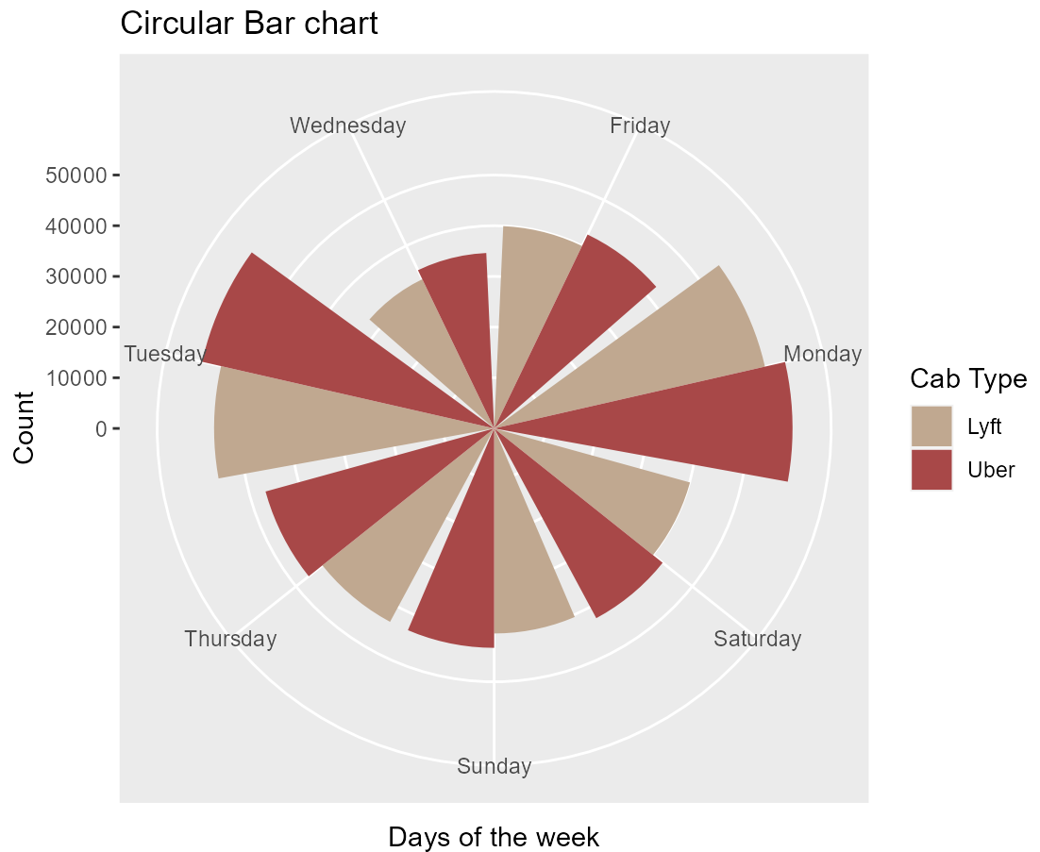


Data Visualization
Monday and Tuesday have the highest counts.
People seem to prefer uber over lyft.
Wednesday has the lowest count.

Slide 12
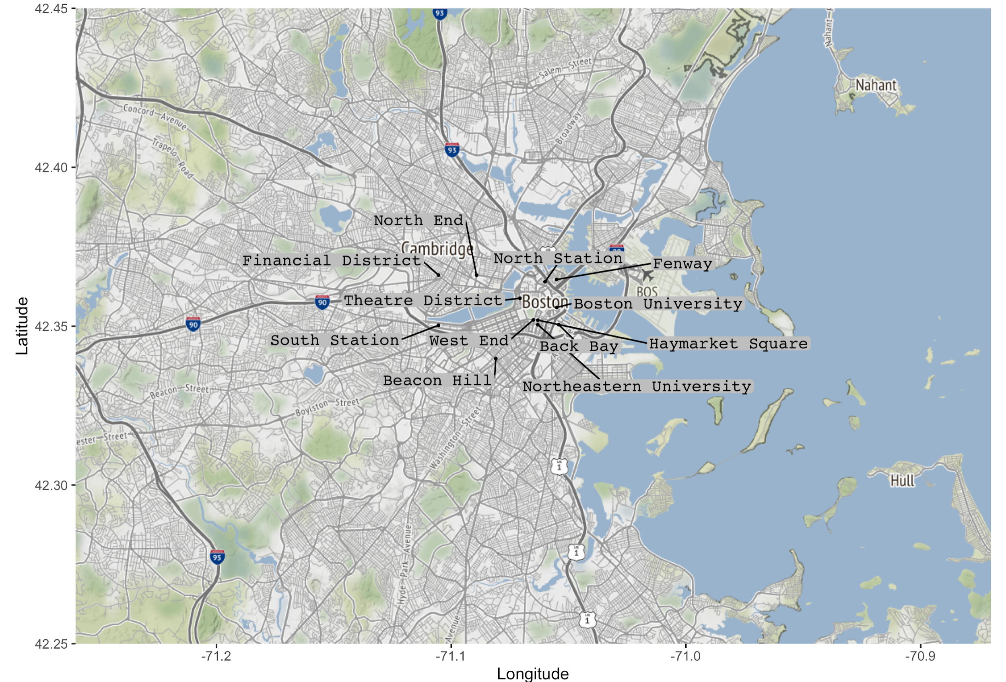

Data Visualization
Prime locations on the map.

Slide 13
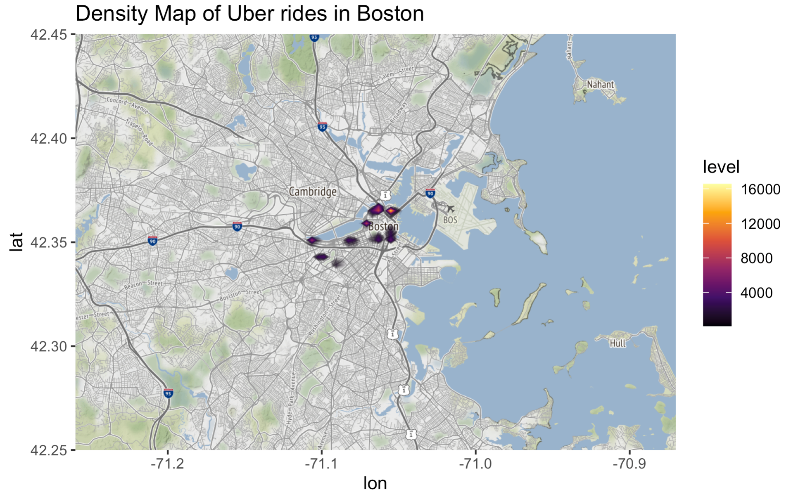

Data Visualization
Shows us the density of the locations.

Slide 14
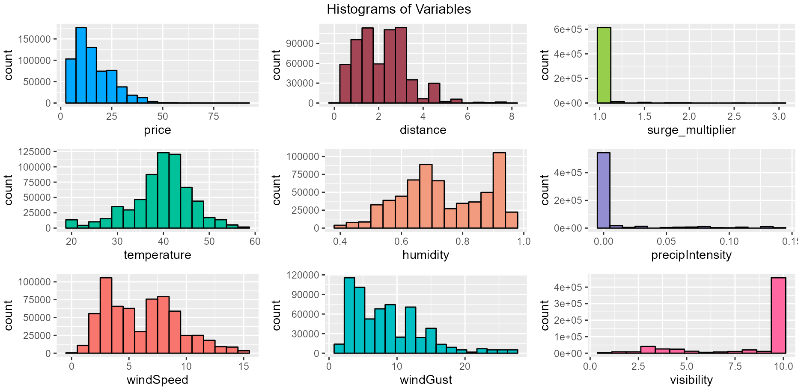


Data Visualization
The price range is between 0-25.
The average distance travelled is between 1-4 range.
Average temperature is between 35-45 F.

Slide 15
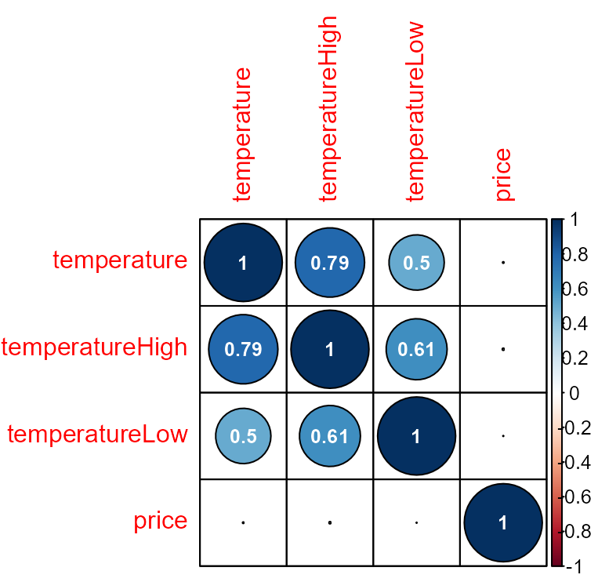

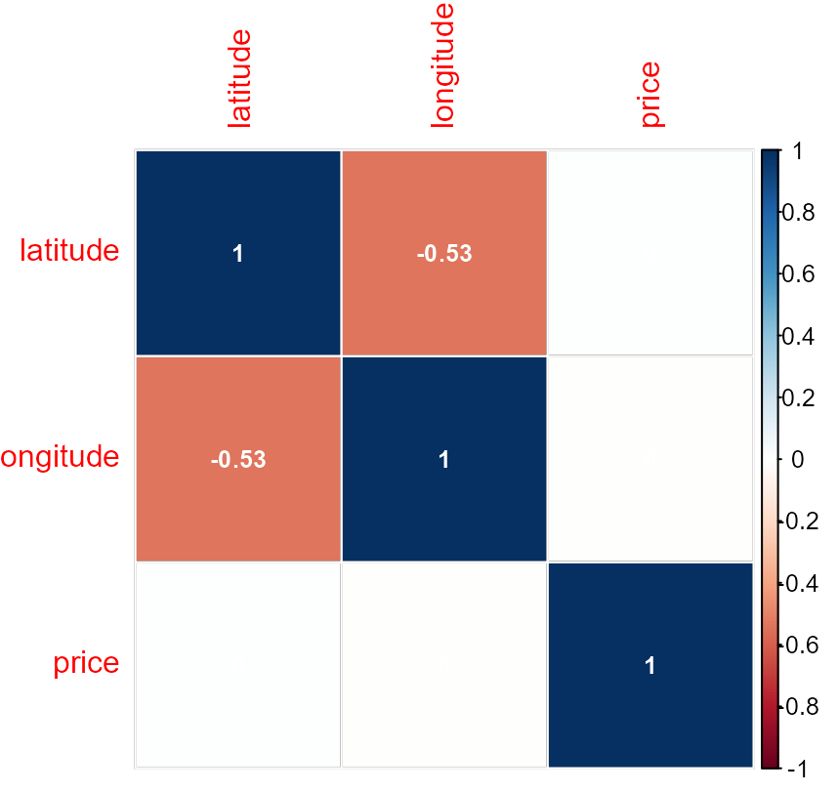

Data Visualization
All temperature-related features have weak correlation with our target feature price
Geographic coordinate features have a low correlation with price

Slide 16
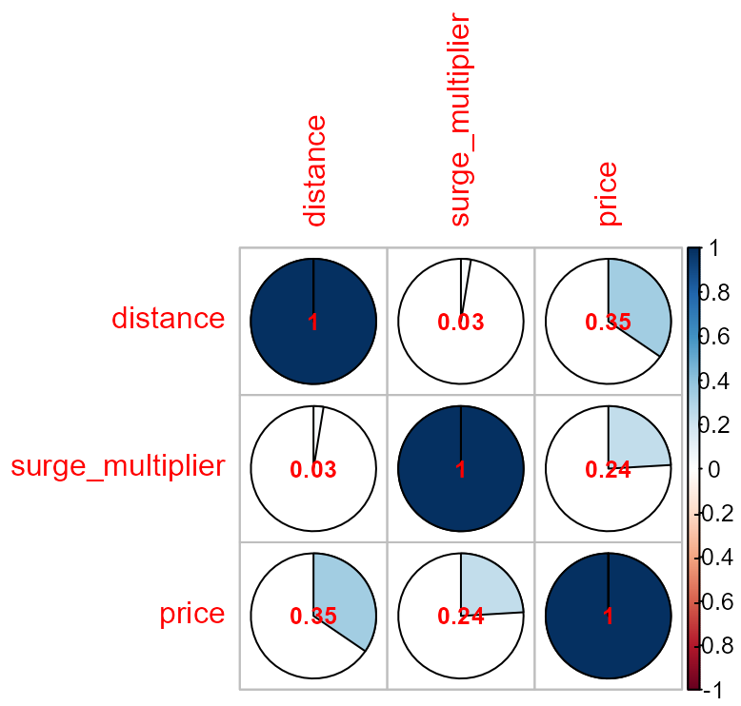

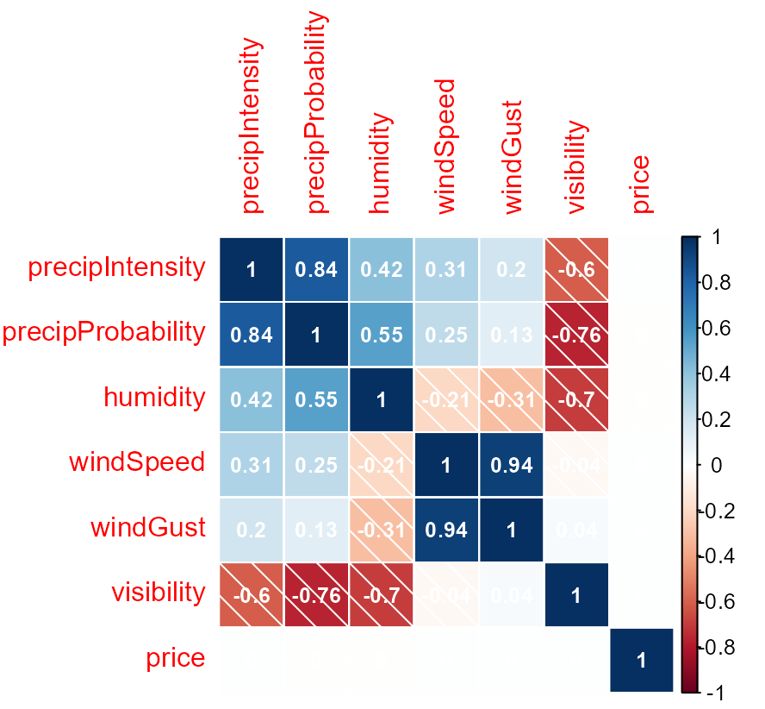

Data Visualization
Distance and surge multiplier have weak positive level of correlation with price
All climate-related features also have a weak correlation with our target feature.

Slide 17
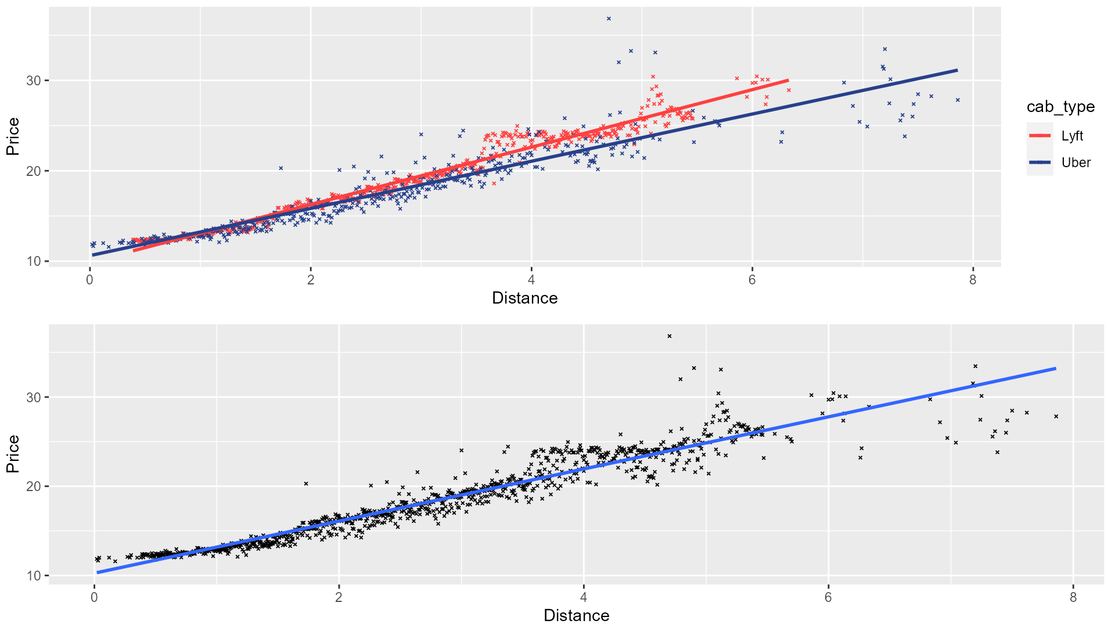

Data Visualization
Price and distance are positively correlated, and majority of the data plots lay close to the regression line.

Slide 18
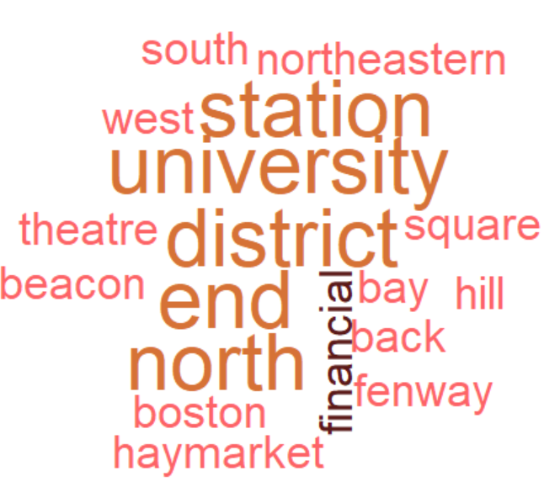


Data Visualization
Most frequently used words in the data set for the location and cab category variable.

Slide 19
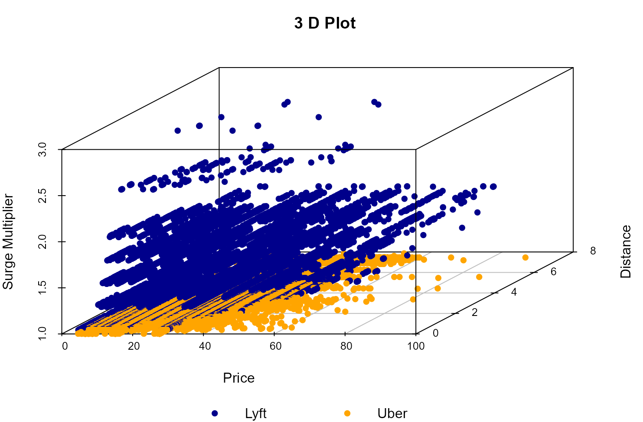
Data Visualization
Lyft charges higher surge multiplier sometimes as high as
High as 3x.

Slide 20
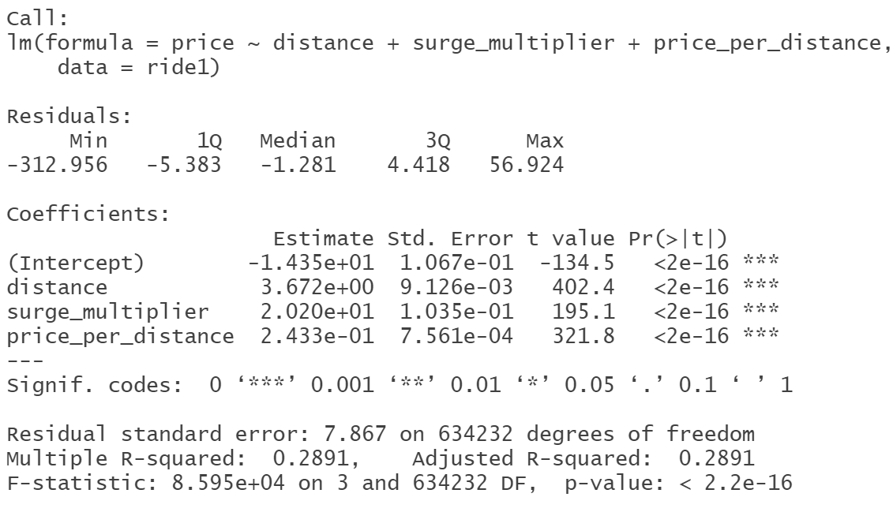
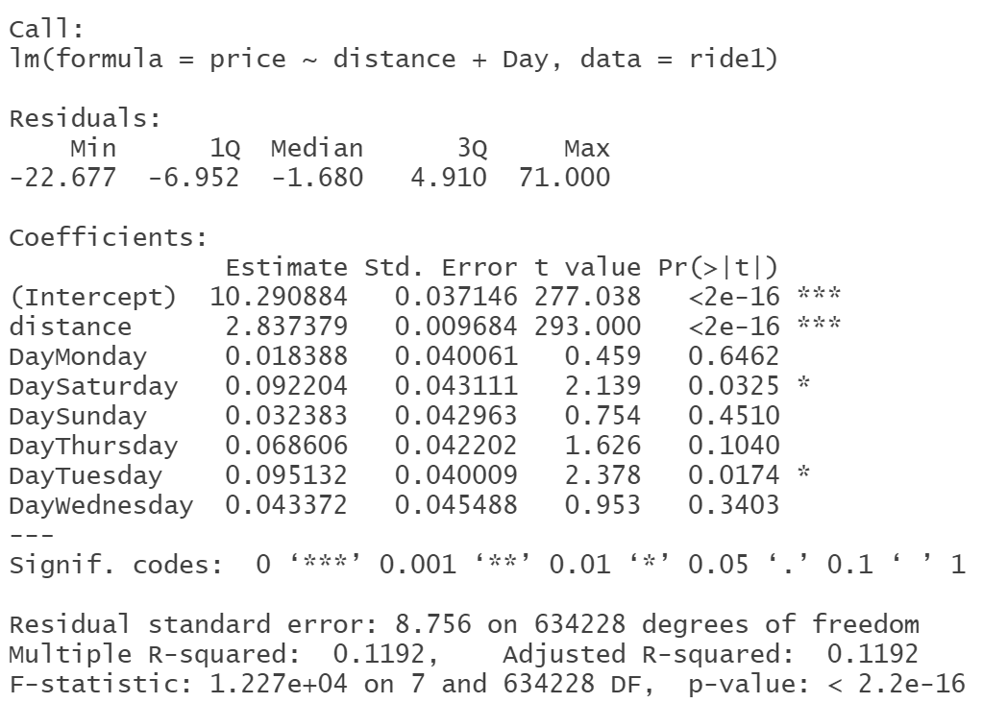
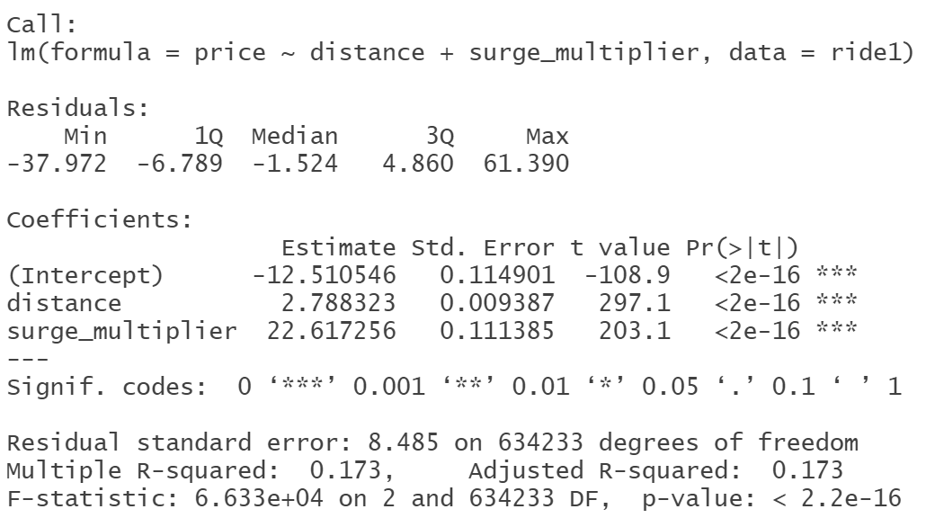

Slide 21
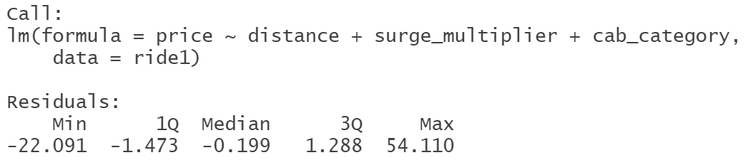
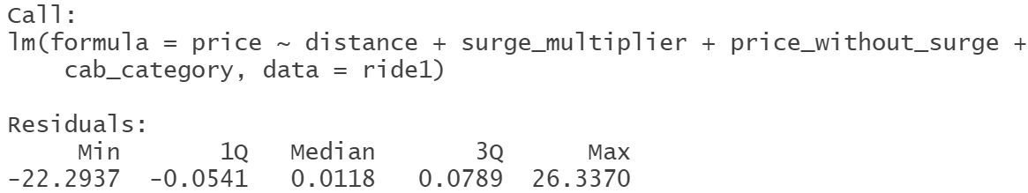
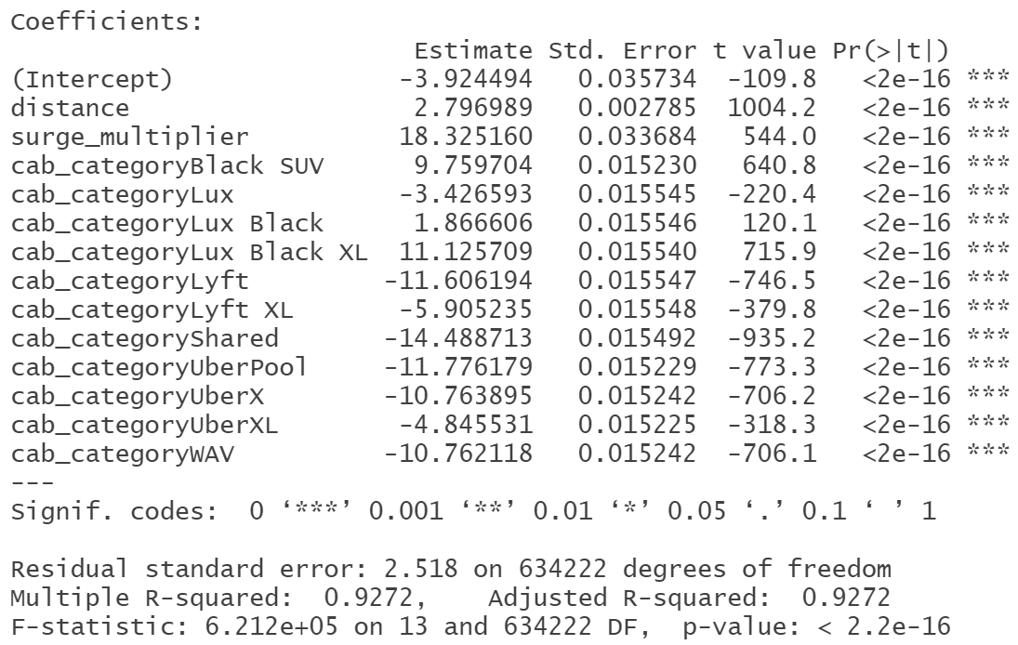
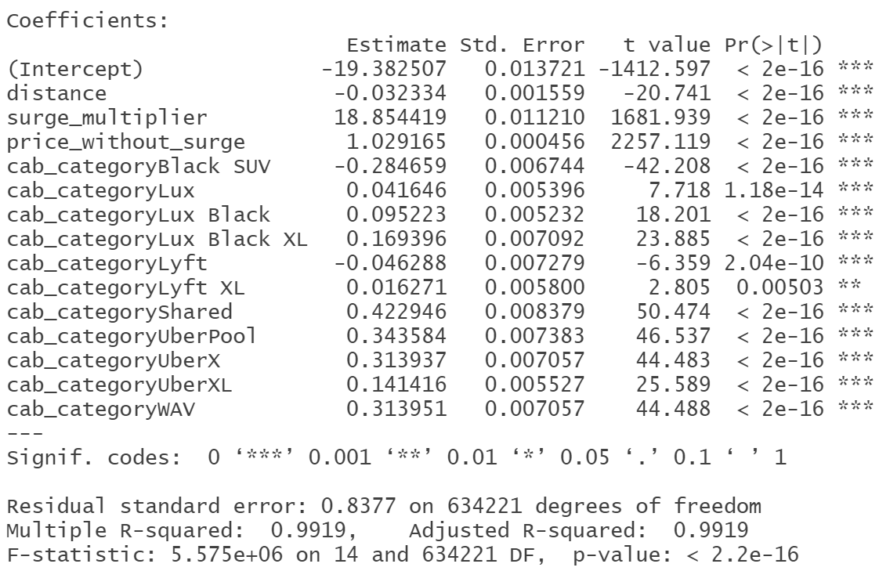

Slide 22
Thank You

